Slide 1
OBJECT ORIENTED
ANALYSIS AND DESIGN
Ch - 1
A study material for the students of GLS University

Slide 2
Introduction to OOAD
OOAD is based on the concepts of object-oriented programming (OOP) and is an organized and systematic approach to designing and developing software systems.
Focuses on real-world modeling using classes and objects.
Divided into two phases:
Object-Oriented Analysis (OOA)
Object-Oriented Design (OOD)

Slide 3
OOAD Phases
OOA (What):
Finding and describing objects or concepts in problem domain
Investigation of problem and requirements
Requirement Analysis
Object based analysis
OOD (How): Create class structures, define relationships, and apply design principles.

Slide 4
Real-World Example: Online Shopping
Imagine you’re building Amazon-like software where customers can:
Browse products
Add them to cart
Place an order
Make payment

Slide 5
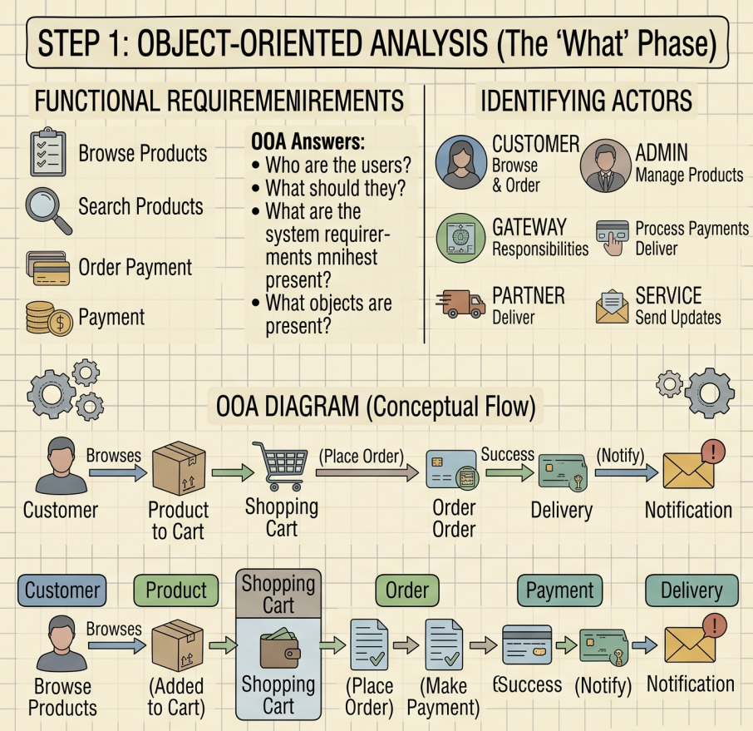

Slide 6
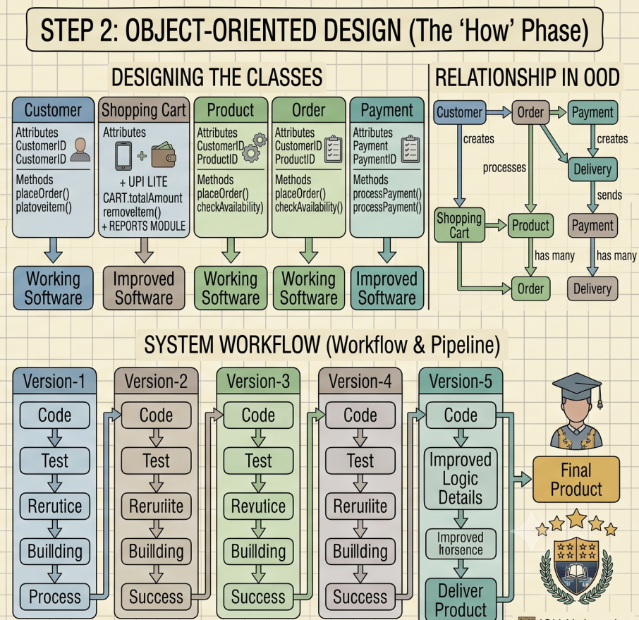

Slide 7
Benefits of OOAD
Reusability: Use of common classes in other projects
Maintainability: Easy to change features (e.g., add reviews)
Scalability: System grows without breaking
Real-world mapping: Easier to design and understand

Slide 8
MCQs
1. What is the full form of OOAD? A. Object-Oriented Analysis and Design B. Object-Oriented Architecture and Development C. Object Organization and Development D. Object-Oriented Application Development
Ans: A. Object-Oriented Analysis and Design
2. Which concept binds data and methods together? A. Abstraction B. Inheritance C. Encapsulation D. Aggregation
Ans: C. Encapsulation

Slide 9
MCQs
3. What is the goal of Object-Oriented Analysis (OOA)? A. To implement classes and objects B. To create test cases C. To understand and model user requirements D. To optimize performance
Ans: C. To understand and model user requirements
4. What is the main goal of Object-Oriented Design (OOD)? A. Write documentation B. Convert analysis model into design model C. Compile the code D. Identify hardware resources
Ans: B. Convert analysis model into design model

Slide 10
MCQs
5. Which phase focuses on identifying "what" the system should do, not "how" to do it? A. OOD B. Coding C. OOA D. Testing
Ans: C. OOA
6. Which phase transforms requirements into a solution design using classes and objects? A. OOA B. OOD C. Coding D. Deployment
Ans: B. OOD

Slide 11
UML
(Unified Modeling Language)

Slide 12
Content
What is UML?
The birth of UML
MDA – the future of UML
Objects and UML
UML Structure
UML building blocks
UML common mechanism
Architecture

Slide 13
What is a model?
A model is a simplified or abstract representation of a real-world system. It helps us understand, analyse, communicate, and test different aspects of a system before it is actually built.
Instead of dealing with all the complexities of a system, a model focuses only on the important details required for a particular purpose.
Types of Models–
Computational Models – represents how a system behaves or performs computations
Examples: Flowcharts, Algorithms, Machine Learning models
Analytical Models - Analyze and evaluate the behaviour, performance, and efficiency of a system.
Examples: Performance analysis, Time complexity analysis, Network analysis
Descriptive Models - Describe the structure and behaviour of a system.
Examples: UML diagrams, Use Case Diagrams, Class Diagrams, Activity Diagrams

Slide 14
What is UML
UML stands for Unified Modeling Language.
UML is a standard visual language/ Graphical language used to:
  Model (visualize) the structure and behavior of a software system
  Document system design before actual coding
  Help teams communicate design ideas clearly
It is based on standards controlled by Object Management Group (OMG).
UML is like a blueprint or map for software. Just like architects use building plans before construction, software engineers use UML diagrams before writing code.

Slide 15
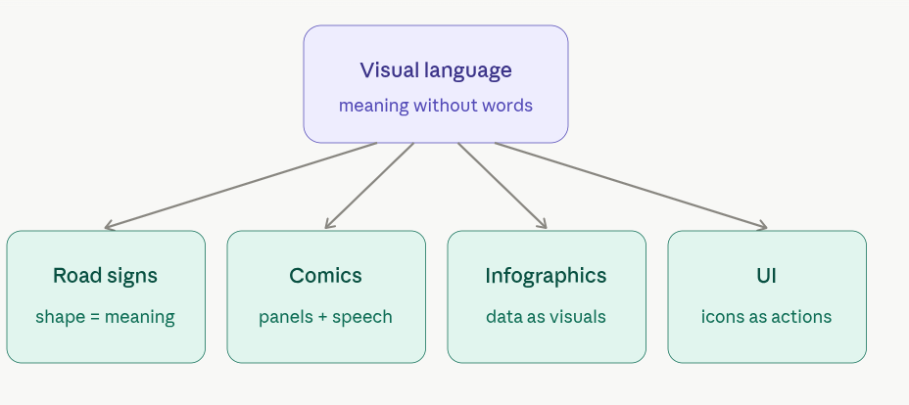
Visual Language
Visual language refers to a system of communication that uses visual elements—such as images, symbols, colors, layout, and design—to convey meaning, ideas, and emotions without (or with minimal) use of words.

Slide 16
Why Visual Language Matters
universal understanding
Faster Processing
Emotionally Engaging
Better Retention

Slide 17
Why UML was needed
In the 1980s and early 1990s:
Software systems were becoming more complex.
Many object-oriented programming languages were emerging (like C++, Smalltalk).
Multiple modeling methods were developed by different experts:
Booch Method (Grady Booch)
OMT – Object Modeling Technique (James Rumbaugh)
OOSE – Object-Oriented Software Engineering (Ivar Jacobson)
These methods all had different notations, tools, and styles. This led to confusion and inconsistency in design processes.
Need for Standardization → Enter UML.

Slide 18
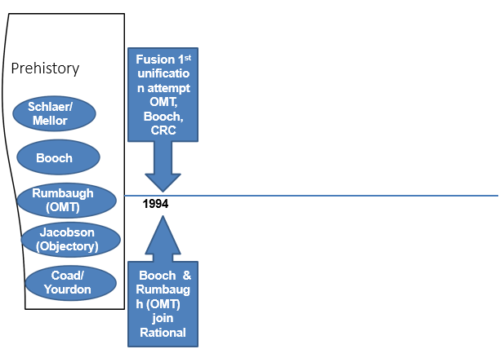
The Birth of UML

Slide 19
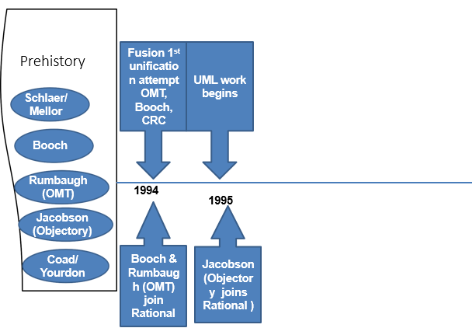

Slide 20
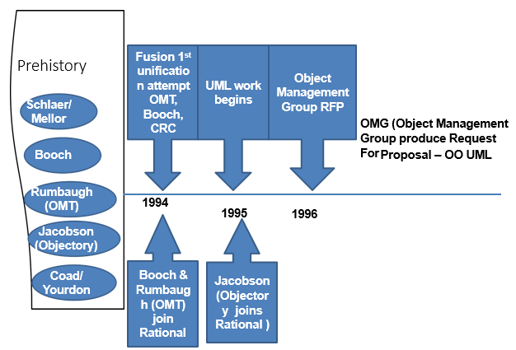

Slide 21
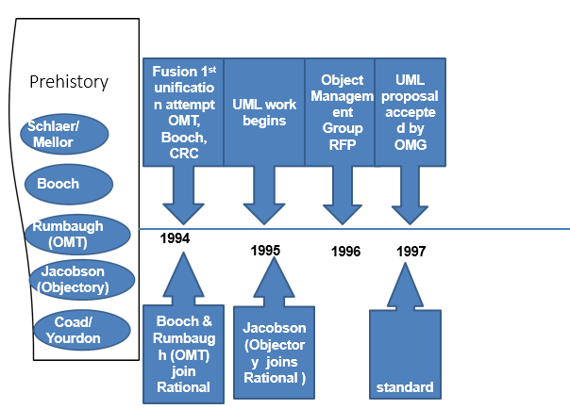

Slide 22
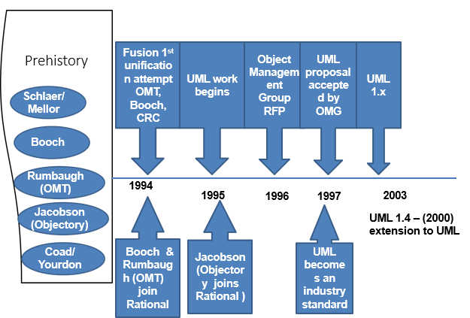

Slide 23
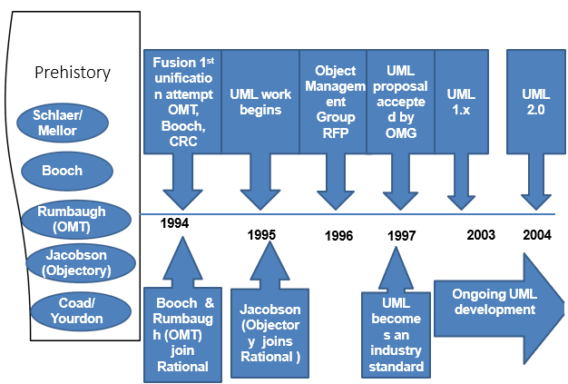
And today, UML is the industry standard for modeling software

Slide 24
The future of UML-MDA
Future of UML defined by – MDA (Model Driven Architecture)
MDA define a vision for how software can be developed
based on models
The production of the executable software architecture
In MDA, software is produced through a series of model
transformations aided by an MDA modeling tool

Slide 25

CIM describes what the business wants.
Very high level of abstraction
Captures key requirements of the system and the vocabulary of the problem domain
Computer Independent
Creation is optional

Slide 26


Expresses the business semantics of the software system
Independent of any underlying platform
Same level of abstraction
More complete
Provide basis to transformed into PSM

Slide 27

Map
Map with PIM to create the PSM
Source code is generated form the PSM

Slide 28

Code
Map
Code
Source code such as Java and C# code, is just the machine code resulting from the compilation of UML models
This code generated as needed directly from PSM

Slide 29
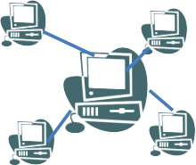
Code
Map
Code
Deploy
MDA shifts UML models from their current role – manually created source code into the primary mechanism of code production

Slide 30
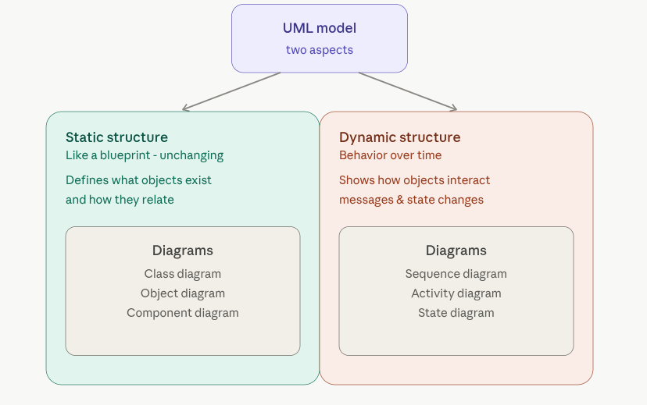
Objects and UML

Slide 31
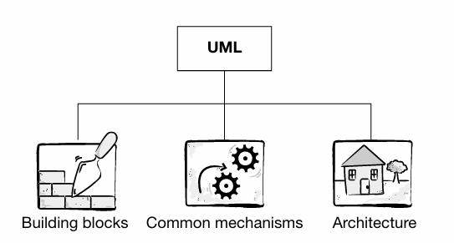
UML Structure
building blocks – these are the basic UML modeling elements, relationships and diagrams
common mechanisms – common UML ways of achieving specific goals;
architecture – standard view of a system’s architecture using different viewpoints

Slide 32
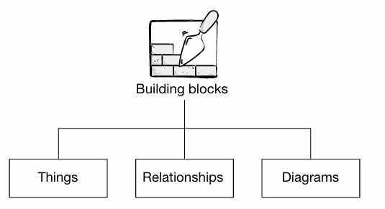
UML Building Blocks

Slide 33
Things (main entities)
These are the modeling elements that are represented in UML diagrams.
  The structural things define the static part of Model.
  Eg. Class, Use Case, Interface, Component
structural
  The behavioral things consists of dynamic part of Model.
  Eg. Interaction, state machine
Behavioral
  Grouping things are the organizational parts of UML Model.
    Eg. Packages
Grouping
  Annotational things are the explanatory part of UML Model.
  Eg. Note
Annotational

Slide 34
Relationships
How elements/things are associated with each other.
It is used to show interaction within the elements in the system.
Types of Relationship –
Association
Aggregation
Composition
Generalization
Realization
Dependency

Slide 35
Association
This relationship describes a set of link.
It also describes how many objects are taking part in the relationship.
No ownership
Symbol: A plain solid line
Direction (optional): Arrow at one or both ends
Example:
Customer Product
(Customer buys Product)

Slide 36
Aggregation
A whole-part relationship, but the part can exist independently of the whole. (weak "Has-a" relationship)
Symbol: A hollow diamond at the whole side
◇──
Weak ownership
Example:
ShoppingCart ◇── Product
(The Shopping Cart has Products. But if the cart is deleted, Products still exist in Amazon)

Slide 37
Composition
A stronger form of aggregation, where the part cannot exist without the whole.
Strong has-a relationship
Symbol: A filled (black) diamond at the whole side
◆──
Type: Strong ownership
Example:
Order ◆── OrderItem (The order items cannot exist without that order.)

Slide 38
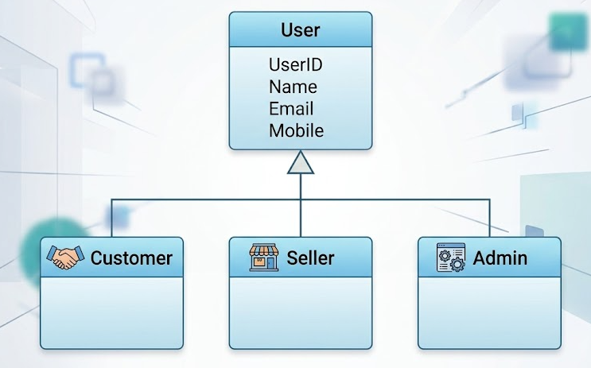
Generalization
Generalization is a relationship in which object of specialized elements are substitutable for object of the generalized element.
Used to show inheritance concept.
Symbol: A solid line with a hollow arrowhead pointing to the parent class.

Slide 39
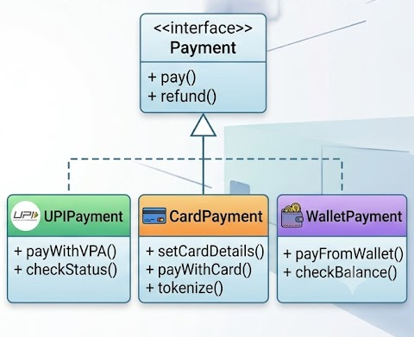
Realization
Realization is a semantic relationship which specifies contract that another element guarantees to carry out.
Used when a class implements an interface.
Interface = Rules/Contract
Class = Person following those rules
Symbol: A dashed line with a hollow triangle arrowhead pointing to the interface.
- - - - - - - - -▷

Slide 40
Dependency
Dependency is the relationship between two things in which change in one element also affects the another one.
Symbol: A dashed line with a regular arrowhead pointing to the depended-upon element.
- - - - - - - - ▶
Example:
Invoice Service - - - - - - - ▶ PDF Generator
OTP Service - - - - - - - ▶ SMS Gaateway

Slide 41
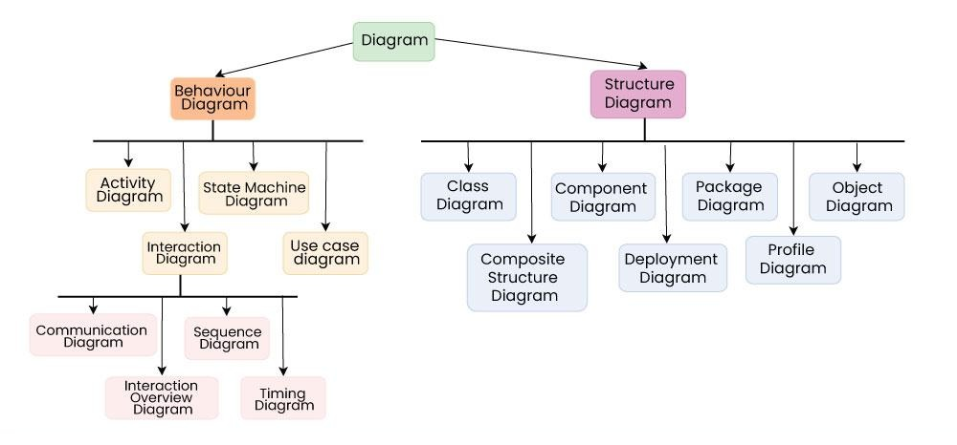
Diagrams
Structural Diagrams : capture static aspects or Structure of a System.
Behavioral Diagrams : Capture dynamic aspects or behavior of a System.

Slide 42
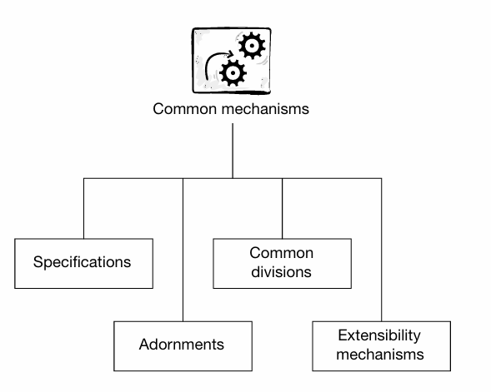
UML common mechanisms
Common Mechanisms are special features provided by UML to make diagrams more expressive, informative, and flexible.

Slide 43
Specifications
Two dimensions
1. Graphical : allow you to model using diagrams and icons
2. Textual : consists of the specifications of the various modeling elements.
Specifications are textual descriptions of the semantics of an element.
They provide the semantic plan of the model

Slide 44
The set of specification is the real “meat” of the model, and forms the semantic backplane that holds the model together and gives it meaning.
For Example :
Doesn’t tell anything about business semantics
Semantic Backplane
Class specification
Use case specification
Dependency specification
Customer
Name Email
Register() Login()

Slide 45
Model may be:
Elided – some element are present in backplane, but hidden in diagram
Incomplete – some missing elements of the model
Inconsistent – model may contain contradictions
For a model to be considered in any way useful or complete the model semantics must be present in the backplane.

Slide 46
Adornment
Adorn model elements on UML diagrams to highlight important details
Constructing a high-level diagram
Show only those adornments that highlight important features of the model and that increase the overall clarity and readability of the diagram

Slide 47
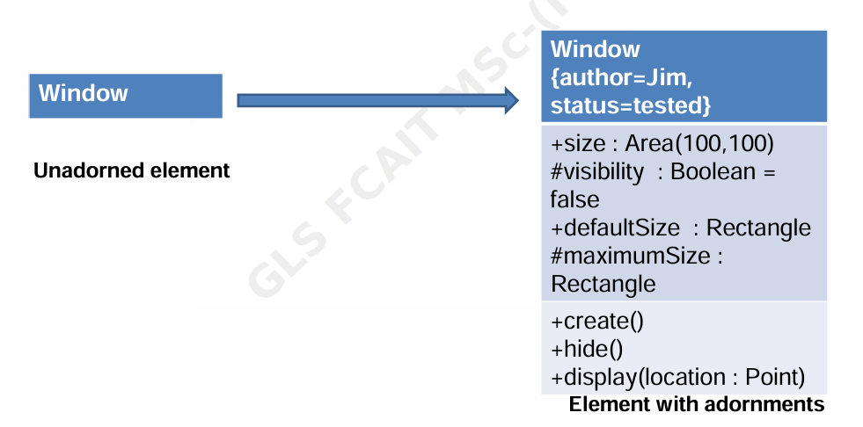
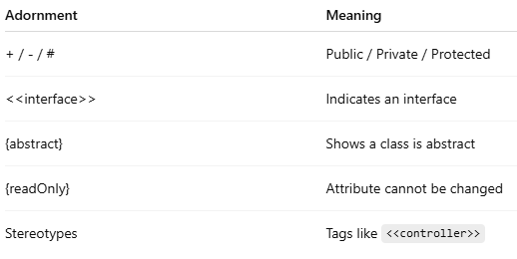
_{For Example -}

Slide 48
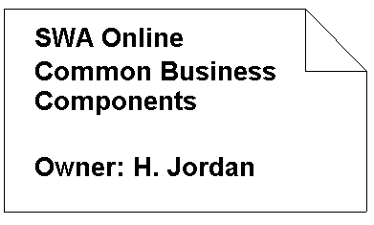
Note
Graphical symbol for rendering constraints or comments attached to an element or collection of elements.
No Semantic Impact: does not alter the meaning of model.
Specify things like: Requirements, Observations, Reviews, Explanations, Constraints.
Graphically, a note is rendered as a rectangle with a dog-eared corner, together with a textual or graphical comment.

Slide 49
Common Divisions
Common Division refers to the practice of logically separating elements in UML into meaningful pairs or roles to make models clear, maintainable, and structured.
It helps to:
Clarify roles and responsibilities
Improve abstraction
Support separation of concerns
Promote flexibility and maintainability

Slide 50
Common Divisions
Two common divisions in UML –
classifier and instance, and interface and implementation
1. Classifier and Instance
Classifier – an abstraction of grouping similar object (a type or blueprint)
e.g. bank account
Instance – concrete things or instance of that abstraction
e.g. your bank account, my bank account
2. Interface and Implementation
Interface – define rules for interaction
- What something should do
- e.g. the button on the front of your VCR
Implementation – realization of the rules define in the interface
- how it does
- e.g. the mechanism inside VCR

Slide 51
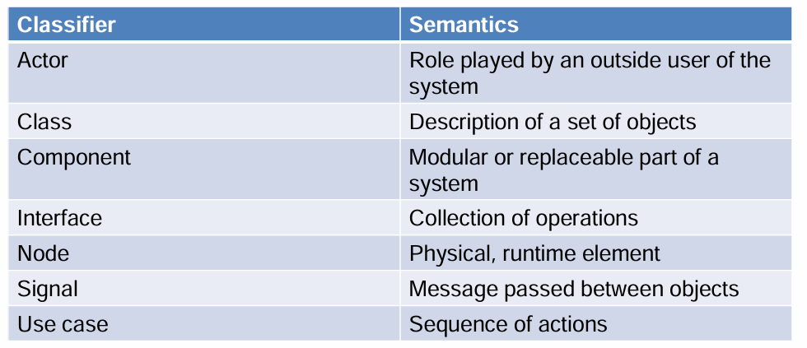

Slide 52
Extensibility mechanisms
UML allows extending the language to suit specific needs — via stereotypes, tagged values, and constraints.
Constraints - Constraints allow you to add new rules to modeling elements
  Use text string in braces { }
2. Stereotypes- Stereotypes allow you to define new modeling elements
- Write name in guillemets <<…>>
3. Tagged values - Tagged values allow you to add your own properties to model elements
- Write like { tag1=value1, tag2=value2, … ,tagN=valueN}

Slide 53
Stereotypes
Stereotypes are used to create new building blocks from existing blocks
New building blocks are domain-specific
Stereotypes are used to extend the vocabulary of a system
Graphically represented as a name enclosed by guillemets (« »)
Example:
<<controller>>, <<entity>>, <<boundary>>,<<interface>>, <<service>>, <<datastore>>
Use:
Clarify role or responsibility
Extend UML element with domain-specific semantics

Slide 54
Tagged Values
Tagged values are used to add to the information of the element (not of its instances)
Stereotypes help to create new building blocks, whereas tagged values help to create new attributes
These are commonly used to specify information relevant to code generation, configuration management and so on

Slide 55
Constraints
Constraints are used to create rules for the model
Rules that impact the behavior of the model, and specify conditions that must be met
Can apply to any element in the model, i.e., attributes of a class, relationship
Graphically represented as a string enclosed by braces {....} and placed near the associated elements or connected to that elements by dependency relationships

Slide 56
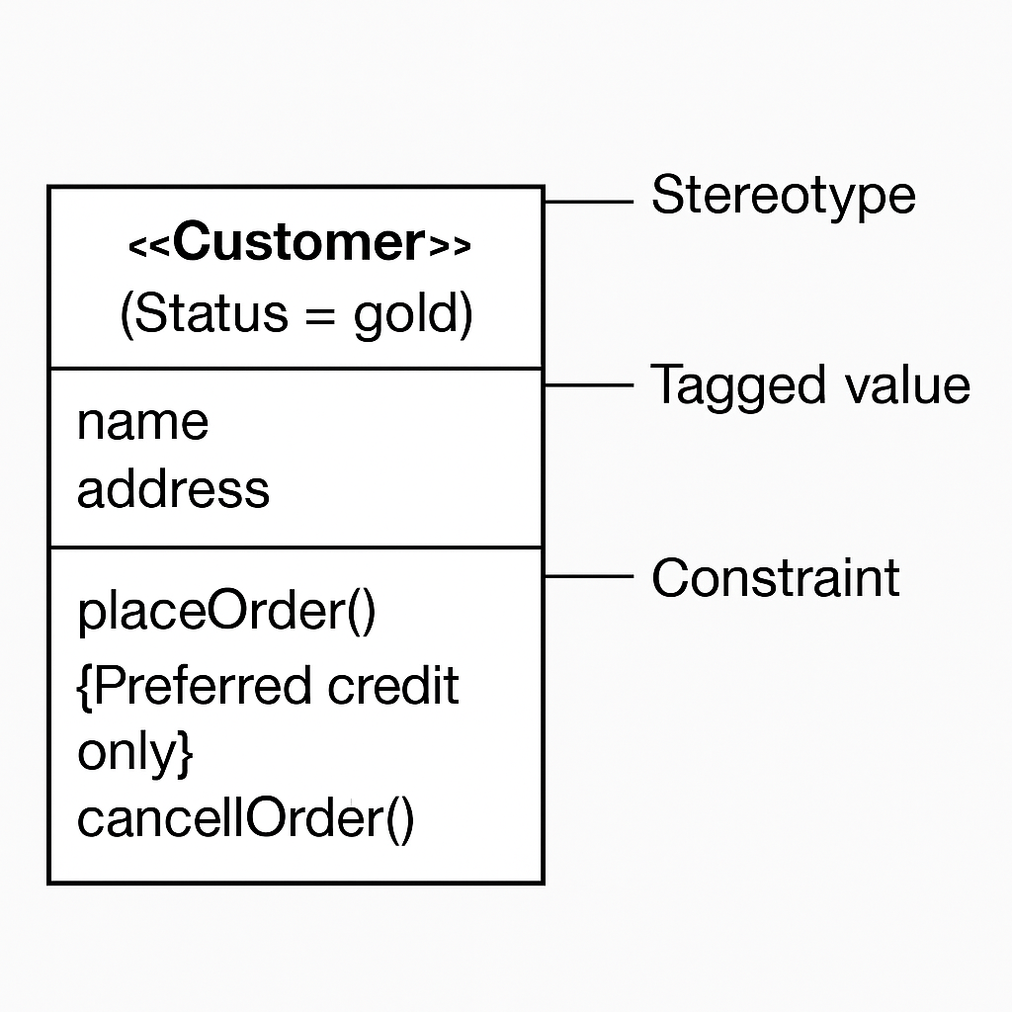

Slide 57
UML Architecture
The UML (Unified Modeling Language) architecture defines how the language itself is structured, not just how it's used to model systems.
Any real-world system is used by different users. The users can be developers, testers, business people, analysts, and many more. Hence, before designing a system, the architecture is made with different perspectives in mind. The most important part is to visualize the system from the perspective of different viewers. The better we understand the better we can build the system.

Slide 58
UML Architecture
“ 4+1 View” architecture also known as the Kruchten’s 4+1 View Model, described by philippe Kruchten
4 views = Logical, Development, Process, Physical
+1 view = Use Case view (central to all others)

Slide 59
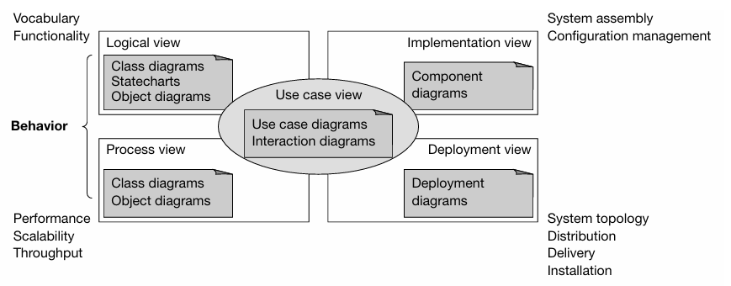

Slide 60
Logical View
Shows functionality of the system from an object-oriented perspective
Describes how the system is broken into classes and objects
Provide functionality to end user
UML Diagrams Used: Class Diagram, Object Diagram, Communication Diagram

Slide 61
Process View
Describes dynamic aspects of the system
• Models the executable threads and processes in a system as active classes
• Concerns with performance, scalability and throughput
UML Diagrams Used: Activity Diagram, Sequence Diagram, State Machine Diagram

Slide 62
Implementation View
Describes the software architecture in terms of modules/components
Focuses on code organization
It shows how the system is built in terms of code and files.
UML Diagrams Used: Component Diagram , Package Diagram

Slide 63
Deployment View
• Describes how the system is deployed physically
Concerns with system topology, distribution, delivery and installation
UML Diagrams Used: Deployment Diagram

Slide 64
Use case View
Capture the basic requirements for the system as a set of use case
Defines scenarios of system behavior
Guides all other views
UML Diagrams Used: Use Case Diagram, Activity Diagram, Sequence Diagram

Slide 65
MCQ’s
1. UML is primarily used for: a) Coding b) Testing c) Modeling software systems d) Designing UI
Answer: c
2. Who maintains UML standards? a) ISO b) Oracle c) IEEE d) OMG (Object Management Group)
Answer: d
3. Which of the following is a structural diagram? a) Activity Diagram b) Use Case Diagram c) Class Diagram d) Sequence Diagram
Answer: c

Slide 66
MCQ’s
4. Which of the following is not a category of UML “Things”? a) Structural b) Behavioral c) Functional d) Annotational
Answer: c
5. Which mechanism provides visual decorations like <<interface>> or {abstract}? a) Extensibility b) Adornments c) Grouping d) Specification
Answer: b

Slide 67
MCQ’s
6. Which of the following is not a type of UML relationship? a) Association b) Aggregation c) Inheritance d) Realization
Answer: c
7. Which view in UML architecture addresses the structure and design of the software? a) Logical view b) Process view c) Development view d) Physical view
Answer: a

Slide 68
MCQ’s
8. What does the ‘+1’ in the 4+1 View Model represent? a) User Interface b) Deployment c) Scenarios or Use Cases d) Class Diagrams
Answer: c
9. In UML, the Physical view is concerned with: a) Class organization b) Component packaging c) Network and deployment configuration d) Thread management
Answer: c

Slide 69
True/False Questions
1. UML diagrams are part of UML building blocks.
True
2. Aggregation is a stronger relationship than composition in UML.
False
3. Generalization represents an "is-a" relationship.
True
4. Realization is used to show interface implementation in UML.
True

Slide 70
THANK YOU

